Slide 1

Bank Management System
Presented By:
Priti Gawade
Prachi Shinkar

Slide 2
Introduction
A Bank Management System is software designed to manage and streamline banking operations efficiently. It handles tasks such as account management, and customer, employee management, ensuring secure and accurate data handling.

Slide 3
Objective
Streamline banking operations like account handling,customer handling, employee handling. .
Ensure the safety and confidentiality of customer and financial data.
Minimize human errors and improve efficiency by automating routine banking tasks.

Slide 4
Technologies
Backend: Java, Hibernate
Database: MySQL
Software: Eclipse IDE, MySQL Workbench

Slide 5
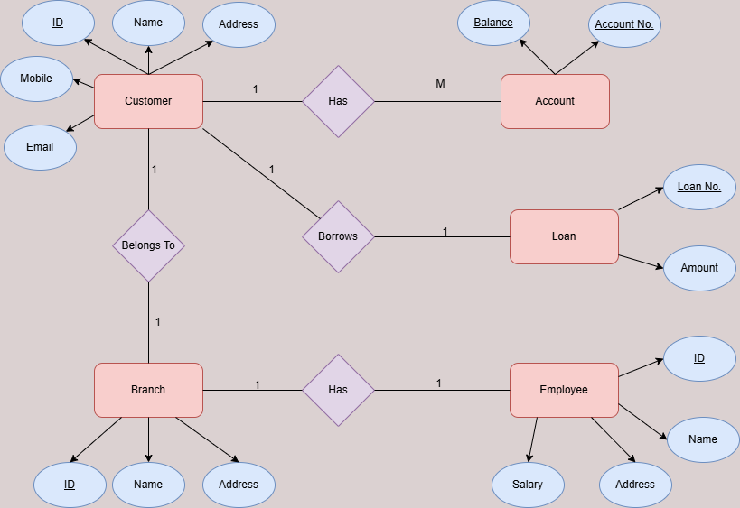
ER Diagram

Slide 6
Features
1. Admin Login:
Provides a login portal for admin to login. The Admin can access the management system and do various tasks such as managing customers, accounts, loans, employees, display branches.
2. Customer Management :
Admin can manage customer details by adding new customers and being able to access the customer data.

Slide 7
3. Account Management :
Admin can manage accounts by adding new accounts as required.
4. Loan Management:
If there are any loans, it can be accessed and displayed by Admin.
5. Employee Management :
Admin can manage employee details by adding data records of employees as required.
6. Accessing Branch Details :
The admin can access the details of existing branches.

Slide 8


